Slide 1
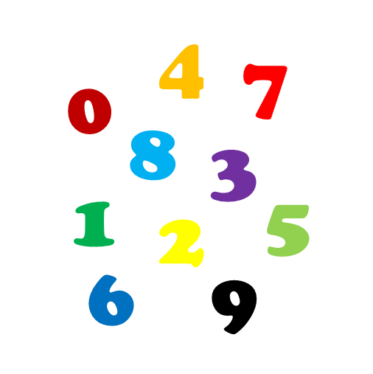
Non-parametric ROC Analysis
Nina Gunnes
March 18, 2021

Slide 2
Diagnostic test
Binary classification test used in medical testing
  Determining whether a subject has a disease or not
Classifying subjects into two groups based on a classification rule
  Subjects predicted to belong to one of the classes
Distinguishing between perfect and imperfect classification
Errors (i.e., false results) appearing in imperfect classification
  False positive (FP): disease detected when it is not present
  False negative (FN): disease not detected when it is present

Slide 3
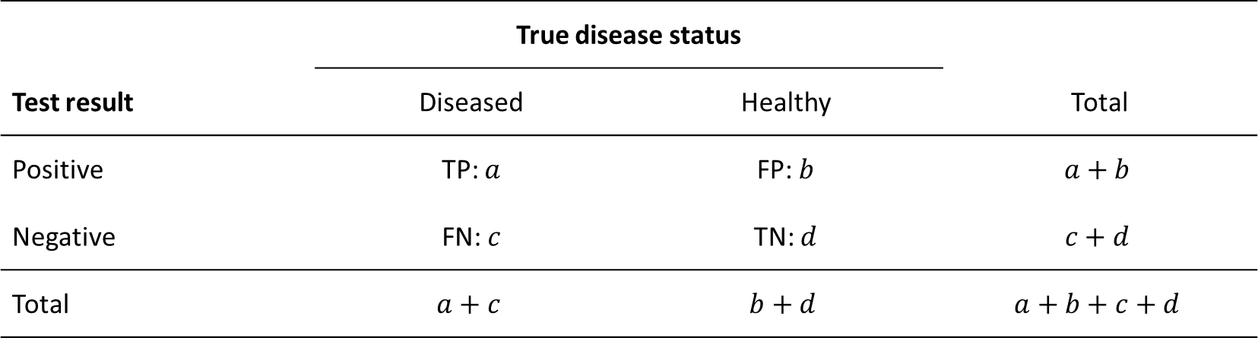
Diagnostic test, cont.
 | True disease status
Test result | Diseased | Healthy | Total
Positive | TP: $a$ | FP: $b$ | $$a+b$$
Negative | FN: $c$ | TN: $d$ | $$c+d$$
Total | $$a+c$$ | $$b+d$$ | $$a+b+c+d$$

Slide 4
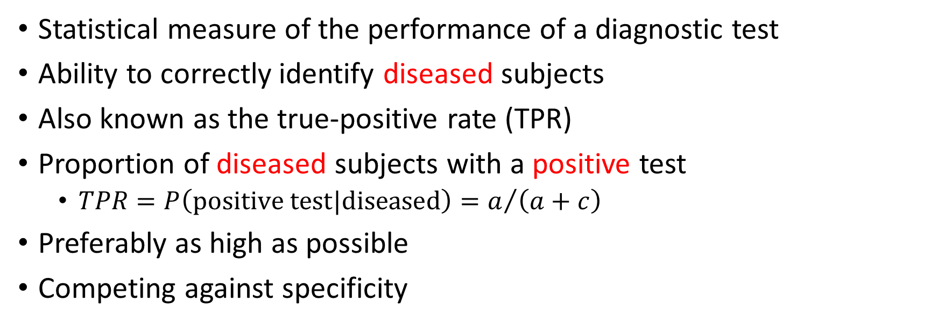
Sensitivity
Statistical measure of the performance of a diagnostic test
Ability to correctly identify diseased subjects
Also known as the true-positive rate (TPR)
Proportion of diseased subjects with a positive test
  $TPR=P\left(\text{positive} \text{test}|\text{diseased}\right)=a/{\left(a+c\right)}$
Preferably as high as possible
Competing against specificity

Slide 5
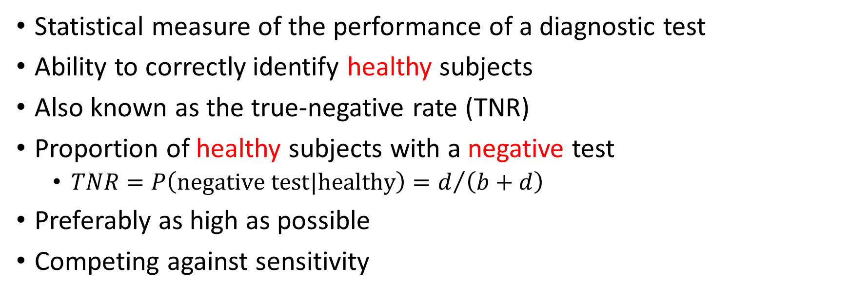
Specificity
Statistical measure of the performance of a diagnostic test
Ability to correctly identify healthy subjects
Also known as the true-negative rate (TNR)
Proportion of healthy subjects with a negative test
  $TNR=P\left(\text{negative} \text{test}|\text{healthy}\right)=d/{\left(b+d\right)}$
Preferably as high as possible
Competing against sensitivity

Slide 6
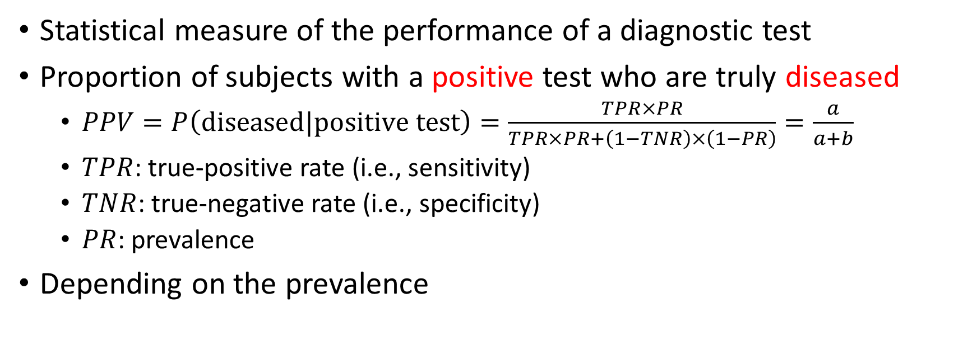
Positive predictive value (PPV)
Statistical measure of the performance of a diagnostic test
Proportion of subjects with a positive test who are truly diseased
  $PPV=P\left(\text{diseased}|\text{positive} \text{test}\right)=\frac{TPR×PR}{TPR×PR+\left(1−TNR\right)×\left(1−PR\right)}=\frac{a}{a+b}$
  $TPR$: true-positive rate (i.e., sensitivity)
  $TNR$: true-negative rate (i.e., specificity)
  $PR$: prevalence
Depending on the prevalence

Slide 7

Negative predictive value (NPV)
Statistical measure of the performance of a diagnostic test
Proportion of subjects with a negative test who are truly healthy
  $NPV=P\left(\text{healthy}|\text{negative} \text{test}\right)=\frac{TNR×\left(1−PR\right)}{TNR×\left(1−PR\right)+\left(1−TPR\right)×PR}=\frac{d}{c+d}$
  $TPR$: true-positive rate (i.e., sensitivity)
  $TNR$: true-negative rate (i.e., specificity)
  $PR$: prevalence
Depending on the prevalence

Slide 8
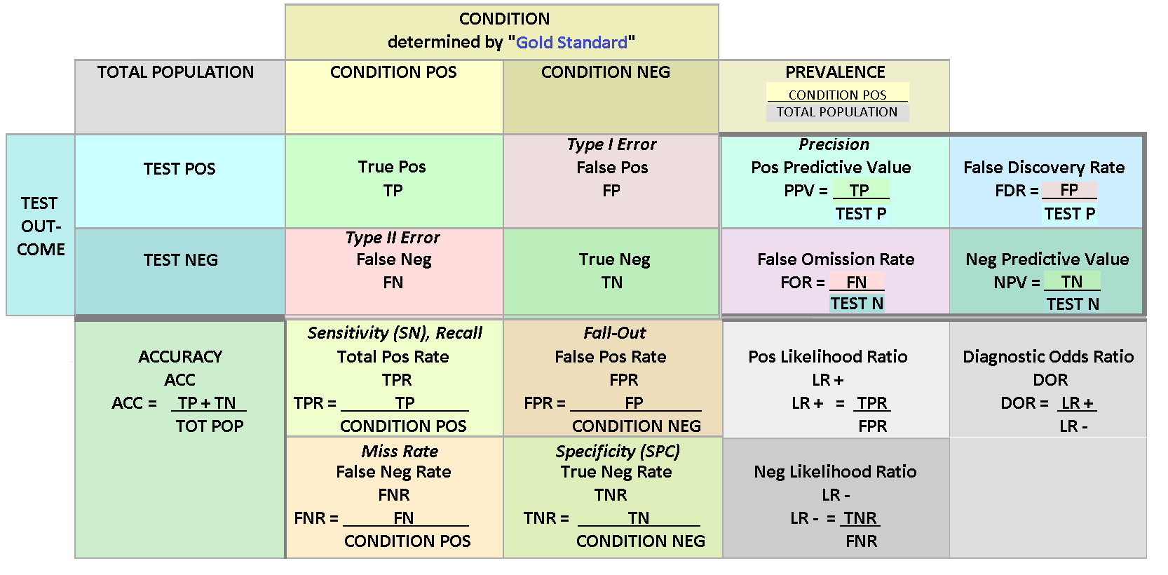
Confusion matrix
"File:Preventive Medicine - Statistics Sensitivity TPR, Specificity TNR, PPV, NPV, FDR, FOR, ACCuracy, Likelihood Ratio, Diagnostic Odds Ratio 2 Final wiki.png" by Lavender888000 is licensed with CC BY-SA 4.0. To view a copy of this license, visit https://creativecommons.org/licenses/by-sa/4.0

Slide 9
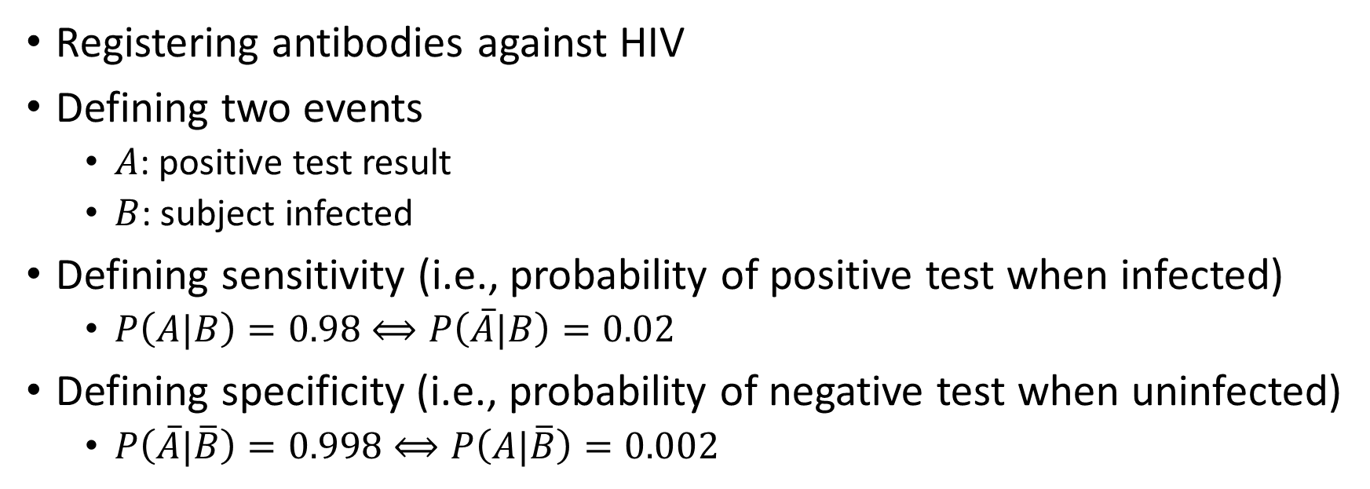
HIV test (Aalen et al., 2006)
Registering antibodies against HIV
Defining two events
  $A$: positive test result
  $B$: subject infected
Defining sensitivity (i.e., probability of positive test when infected)
  $P\left(A|B\right)=0.98⟺P\left(\overline{A}|B\right)=0.02$
Defining specificity (i.e., probability of negative test when uninfected)
  $P\left(\overline{A}|\overline{B}\right)=0.998⟺P\left(A|\overline{B}\right)=0.002$

Slide 10
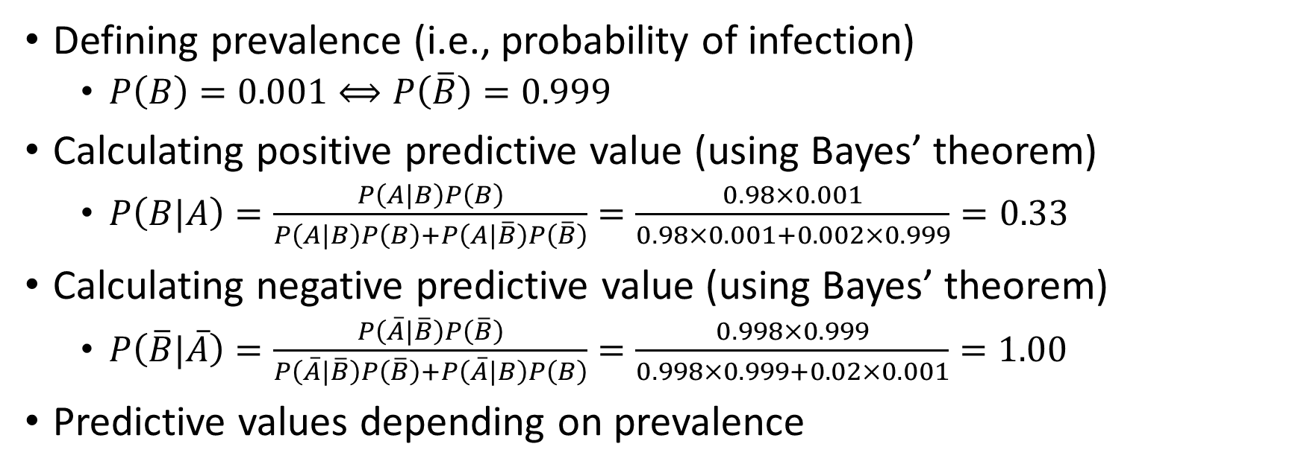
HIV test (Aalen et al., 2006), cont.
Defining prevalence (i.e., probability of infection)
  $P\left(B\right)=0.001⟺P\left(\overline{B}\right)=0.999$
Calculating positive predictive value (using Bayes’ theorem)
  $P\left(B|A\right)=\frac{P\left(A|B\right)P\left(B\right)}{P\left(A|B\right)P\left(B\right)+P\left(A|\overline{B}\right)P\left(\overline{B}\right)}=\frac{0.98×0.001}{0.98×0.001+0.002×0.999}=0.33$
Calculating negative predictive value (using Bayes’ theorem)
  $P\left(\overline{B}|\overline{A}\right)=\frac{P\left(\overline{A}|\overline{B}\right)P\left(\overline{B}\right)}{P\left(\overline{A}|\overline{B}\right)P\left(\overline{B}\right)+P\left(\overline{A}|B\right)P\left(B\right)}=\frac{0.998×0.999}{0.998×0.999+0.02×0.001}=1.00$
Predictive values depending on prevalence

Slide 11
HIV test (Aalen et al., 2006), cont.

Slide 12
Receiver operating characteristic (ROC)
Quantifying the accuracy of a diagnostic test
Using the ROC curve
  Graph of sensitivity versus 1 - specificity of the diagnostic test
Interpreted as a two-stage process
  Control distribution of classifier estimated
  Classifier standardized to 1 - percentile value (FPR) using control distribution
  ROC curve estimated as case distribution of standardized classifier values

Slide 13
Area under the ROC curve (AUC)
Summarizing the global performance of a diagnostic test
Interpreted as a probability
  Test result greater for a diseased subject than for a healthy subject
The greater the AUC, the better the global performance of the test

Slide 14
Data example
Stata Base Reference Manual, Release 15
  Example 1 on page 2435 (“Nonparametric ROC analysis” section)
Data from a study by Hanley and McNeil (1982)
  Patients classified by a reviewer
Tomographic images from 109 patients with neurological problems
Patients grouped according to disease status
  0: normal (58 normal patients)
  1: abnormal (51 abnormal patients)

Slide 15
Data example, cont.
Patients classified using a 5-point rating scale
  1: definitely normal (36 patients)
  2: probably normal (8 patients)
  3: questionable (8 patients)
  4: probably abnormal (22 patients)
  5: definitely abnormal (35 patients)

Slide 16

In Stata: Data load
Using webuse command
Data available on Stata’s website
  https://www.stata-press.com/data/
Loading data set over the web
  Name: hanley

Slide 17
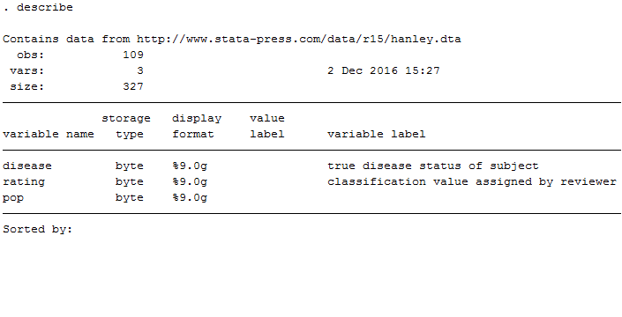
In Stata: Data inspection
Using describe command
Describing data in memory
  Summary of the data set

Slide 18
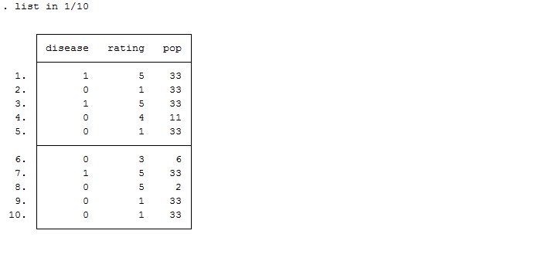
In Stata: Data inspection, cont.
Using list command
Listing values of variables

Slide 19
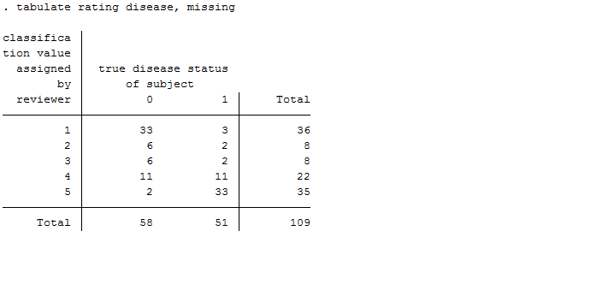
In Stata: Data inspection, cont.
Using tabulate command
Tabulating two variables
  Variable 1: rating
  Variable 2: disease

Slide 20
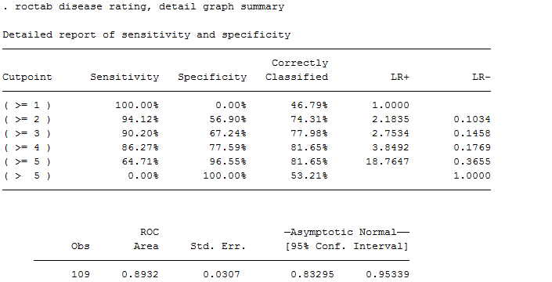
In Stata: Non-parametric ROC analysis
Using roctab command
Performing ROC analysis
  Reference variable: disease
  Rating variable: rating

Slide 21
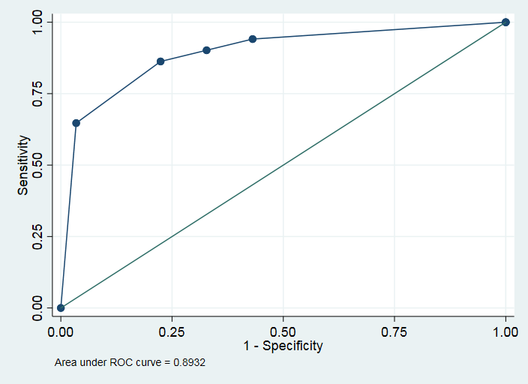
In Stata: Non-parametric ROC analysis, cont.

Slide 22
References
Aalen OO, Frigessi A, Moger TA, Scheel I, Skovlund E, Veierød MB. Statistiske metoder i medisin og helsefag. Oslo: Gyldendal akademisk; 2006.
Hanley JA, McNeil BJ. The meaning and use of the area under a receiver operating characteristic (ROC) curve. Radiology. 1982;143(1):29–36. doi:10.1148/radiology.143.1.7063747
Laake P, Hjartåker A, Thelle DS, Veierød MB. Epidemiologiske og kliniske forskningsmetoder. Oslo: Gyldendal akademisk; 2007. https://www.med.uio.no/imb/forskning/publikasjoner/boker/2007/epidemiolgiske-kliniske-forskningsmetoder.html.
StataCorp. 2017. Stata 15 Base Reference Manual. College Station, TX: Stata Press.
Wikipedia contributors. (2020, December 5). Binary classification. In Wikipedia, The Free Encyclopedia. Retrieved 17:02, March 17, 2021, from https://en.wikipedia.org/w/index.php?title=Binary_classification&oldid=992413365
Wikipedia contributors. (2021, March 16). Classification rule. In Wikipedia, The Free Encyclopedia. Retrieved 17:04, March 17, 2021, from https://en.wikipedia.org/w/index.php?title=Classification_rule&oldid=1012476610
Wikipedia contributors. (2021, February 27). Confusion matrix. In Wikipedia, The Free Encyclopedia. Retrieved 17:04, March 17, 2021, from https://en.wikipedia.org/w/index.php?title=Confusion_matrix&oldid=1009198831
Wikipedia contributors. (2021, March 14). Sensitivity and specificity. In Wikipedia, The Free Encyclopedia. Retrieved 17:05, March 17, 2021, from https://en.wikipedia.org/w/index.php?title=Sensitivity_and_specificity&oldid=1011999716

